Slide 1
Impact of El Niño on Groundwater Levels in Chennai: Analysis and Identification of Recharge Potential Areas Using Satellite Imagery and Temporal Data
REVIEW II
PROJECT GUIDE: Dr. Sandhya P
TEAM MEMBERS: Shaikh Rumman Fardeen (21BCE1736) & Shashank Kumar (21BCE1887)

Slide 2

AGENDA
Guide Approval mail snapshot
Introduction
Literature Review
Problem Statement
Research Challenges
Research Objective
Methodology
Proposed System
What is to be done next
References

Slide 3
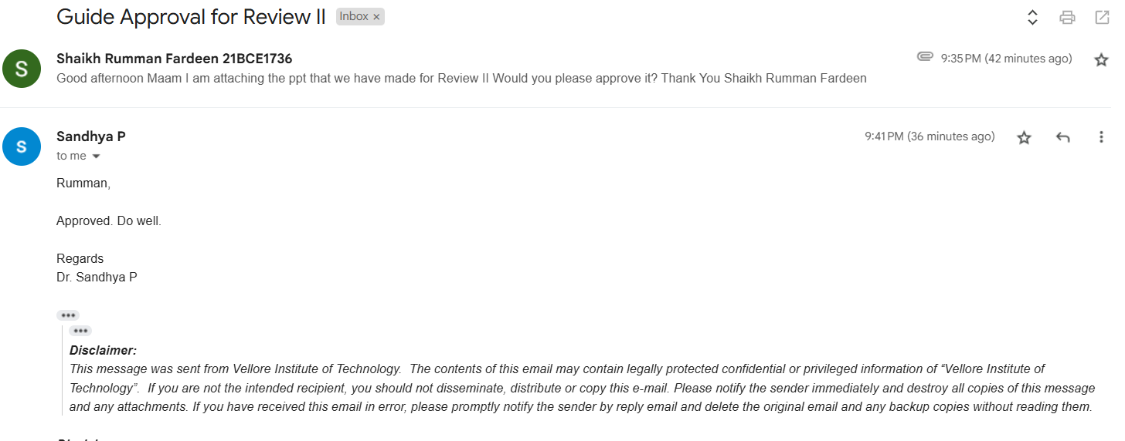
GUIDE APPROVAL MAIL

Slide 4
INTRODUCTION
El Niño - It is a climatic phenomenon where warming in the Pacific Ocean disrupts global weather, causing droughts, floods, and temperature shifts worldwide.
Monsoonal Impact on Chennai – El Niño weakens the southwest monsoon, causing droughts, while intensifying the northeast monsoon, leading to flooding in Chennai.
Chennai’s Water Struggle - The city faces extreme groundwater fluctuations, causing shortages and floods, worsened by population growth, urbanization, and poor water infrastructure.

Slide 5
PROBLEM STATEMENT
The project addresses the challenges posed by fluctuating groundwater levels in Chennai, driven by the irregular impacts of El Niño on monsoonal rainfall. These climatic variations result in water scarcity, flooding, and inadequate recharge. By analyzing groundwater trends and identifying recharge potential areas, the study aims to promote sustainable water resource management and climate resilience.

Slide 6
OBJECTIVES
Predict Groundwater Levels – Use historical data and predictive models to forecast groundwater fluctuations during El Niño seasons for better water management.
Identify Rainwater Harvesting Locations – Analyze satellite imagery and groundwater models to find optimal sites for rainwater storage, considering topography and soil infiltration for efficient harvesting.
Enhance Groundwater Recharge – Use rainwater harvesting sites to recharge groundwater in depleted areas, especially in urban and peri-urban regions, ensuring better sustainability.

Slide 7
PROPOSED SYSTEM
Objective - Provide accurate groundwater predictions and identify optimal locations for water storage and recharge interventions, focusing on El Niño impacts in Chennai.
Key Modules - Data Collection and Preprocessing, Predictive Modeling, Recharge Potential Identification, Monthly Anomalies Detection and Decision Support for Water Resource Management
Key Features - Data Integration, Predictive Modeling, Location Identification and Real-Time Monitoring
Scope - Initially for urban and peri-urban areas in Chennai, with potential for expansion to other regions facing similar water issues.

Slide 8
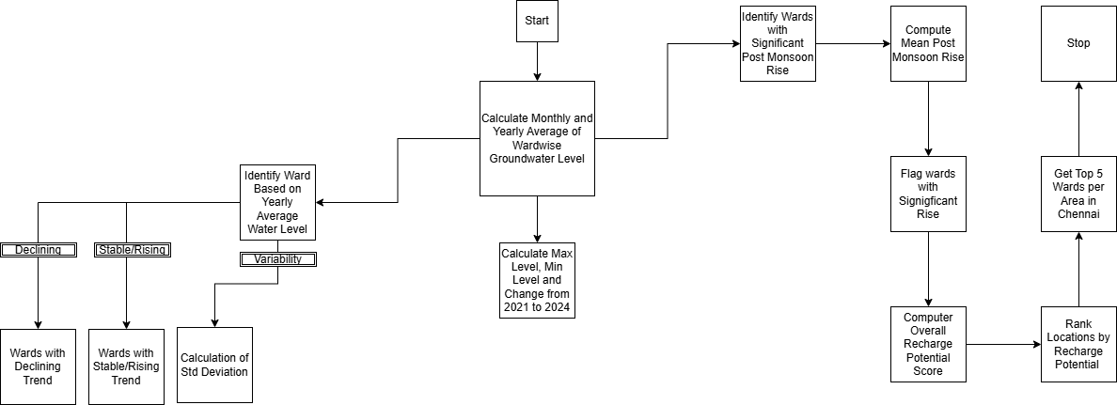
PROPOSED SYSTEM
Data Analysis Flowchart

Slide 9
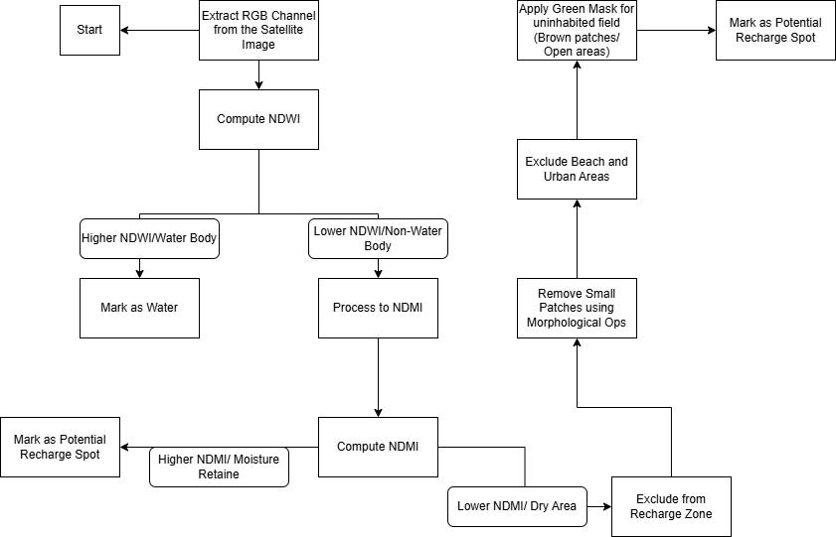
PROPOSED SYSTEM
Satellite Image Analysis Flowchart

Slide 10
LIST OF MODULES
The architecture consists of the following 9 modules -
Module 1: Data Collection and Preprocessing
Module 2: Temporal analysis
Module 3: Groundwater Trends Analysis
Module 4: Ward-Wise Groundwater Level Comparison
Module 5: Identifying Wards with Significant Post-Monsoon Rises
Module 6: Ranking Wards Based on Recharge Potential
Module 7: Extract RGB Channels from satellite images
Module 8: Compute NDWI and NDMI
Module 9: Morphological operations

Slide 11
MODULE 1: DATA COLLECTION AND PREPROCESSING
Objective:
Collect and preprocess the climate, groundwater, and satellite data for further analysis.
Steps:
Groundwater Data: Historical groundwater levels across different wards.
Satellite Data: MODIS NDVI and imagery for identifying land use and vegetation patterns.
Preprocessing Techniques:
Normalization of the data for uniform scale.
Data cleaning (handling missing values, removing outliers).
Feature selection to focus on key influencing factors.

Slide 12
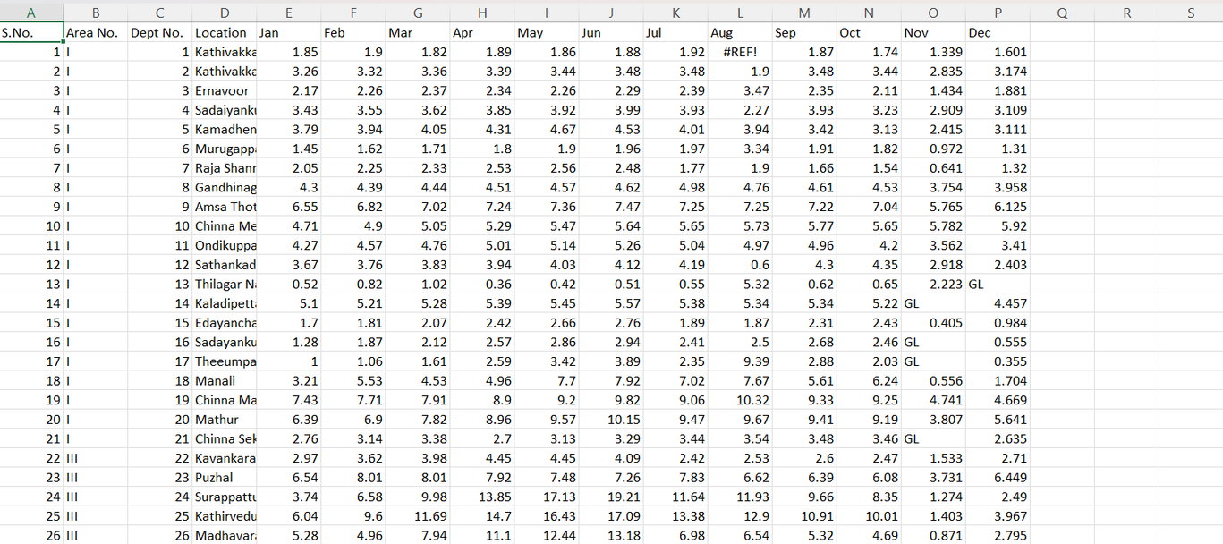
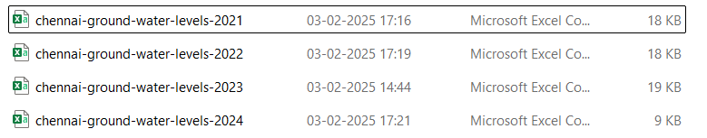
MODULE 1: DATA COLLECTION AND PREPROCESSING
Dataset from CGWB(Central Ground Water Board)

Slide 13
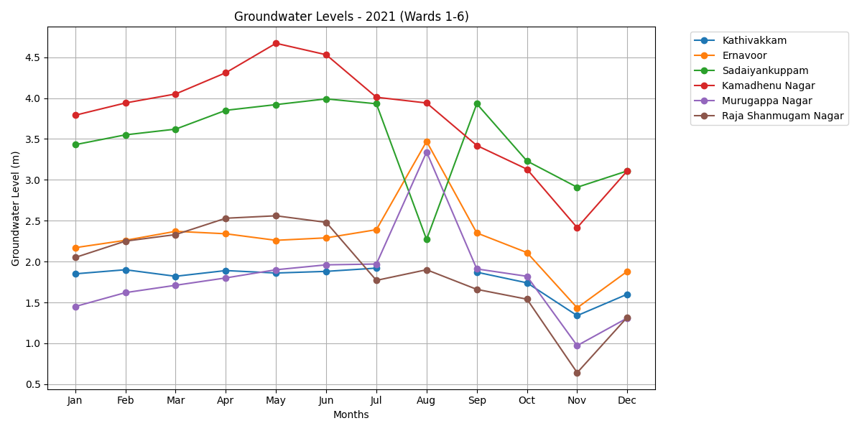
MODULE 1: DATA COLLECTION AND PREPROCESSING
Visualization of the data using Matplotlib

Slide 14
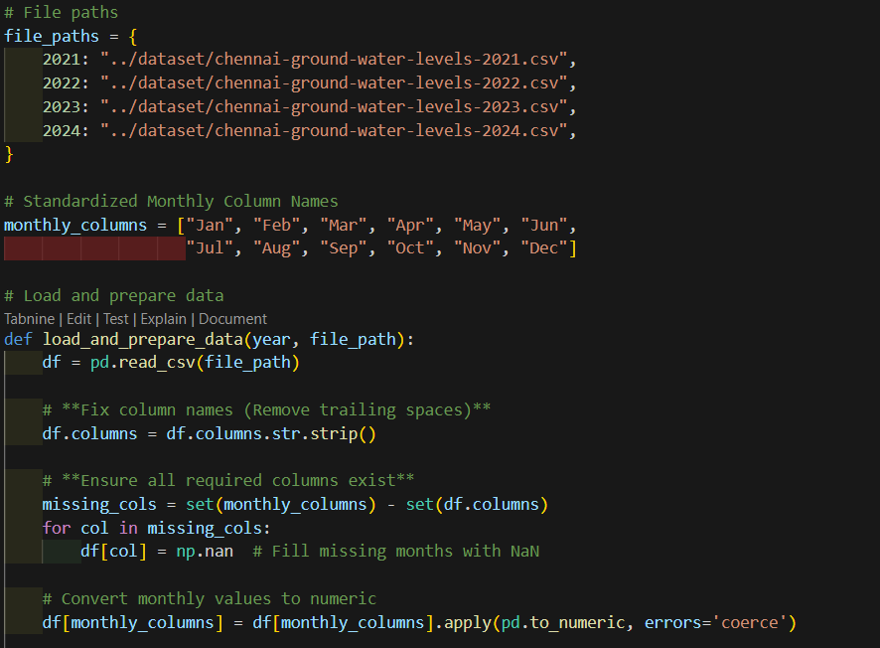
MODULE 1: DATA COLLECTION AND PREPROCESSING
Code for Data fetching and preprocessing

Slide 15
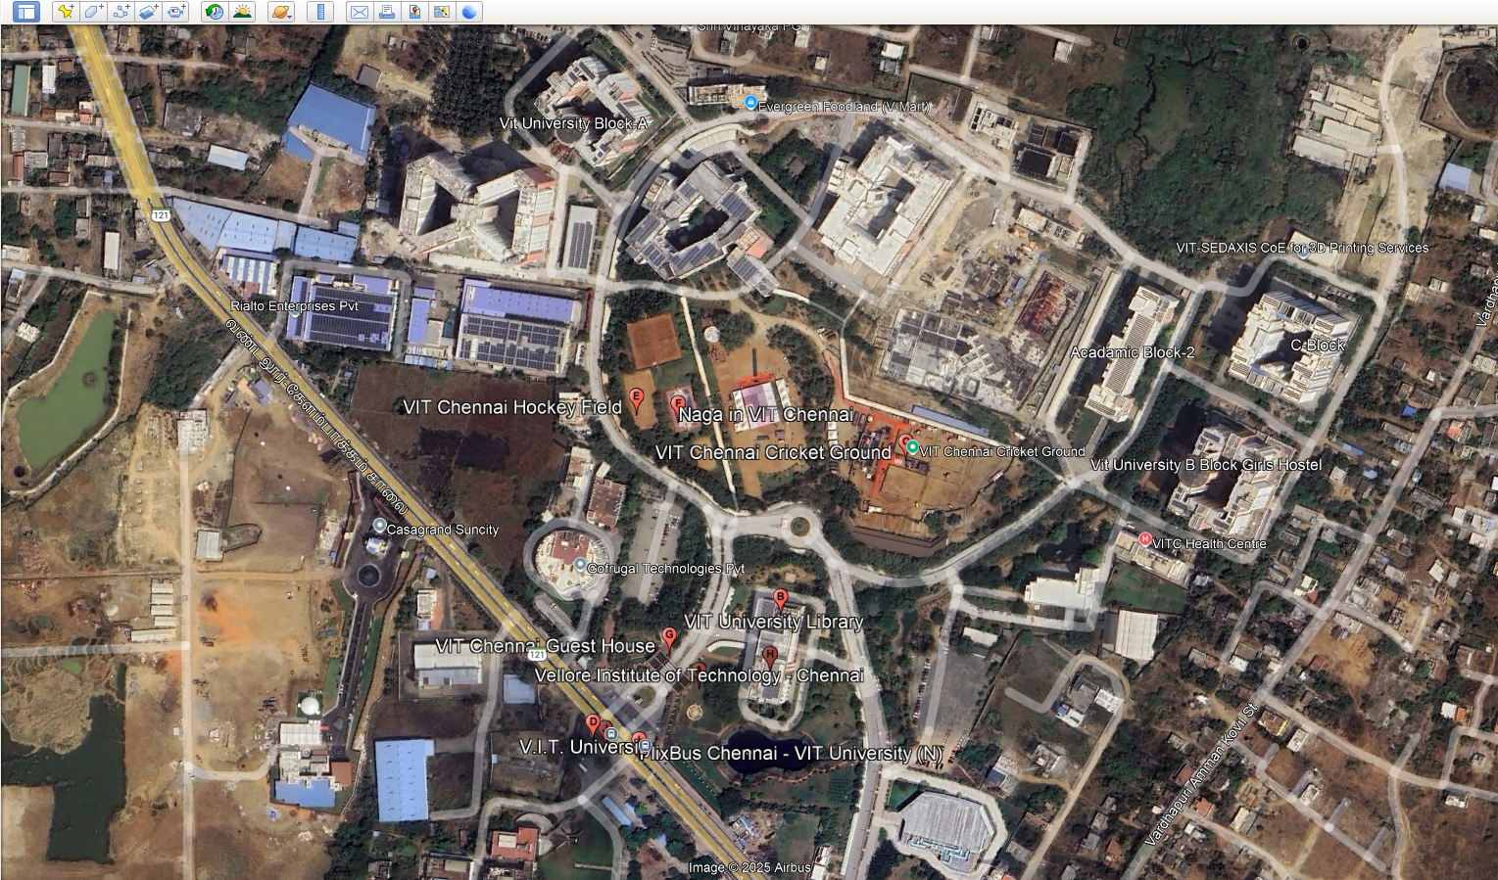
MODULE 1: DATA COLLECTION AND PREPROCESSING
Sample Satellite Image - VIT Chennai

Slide 16
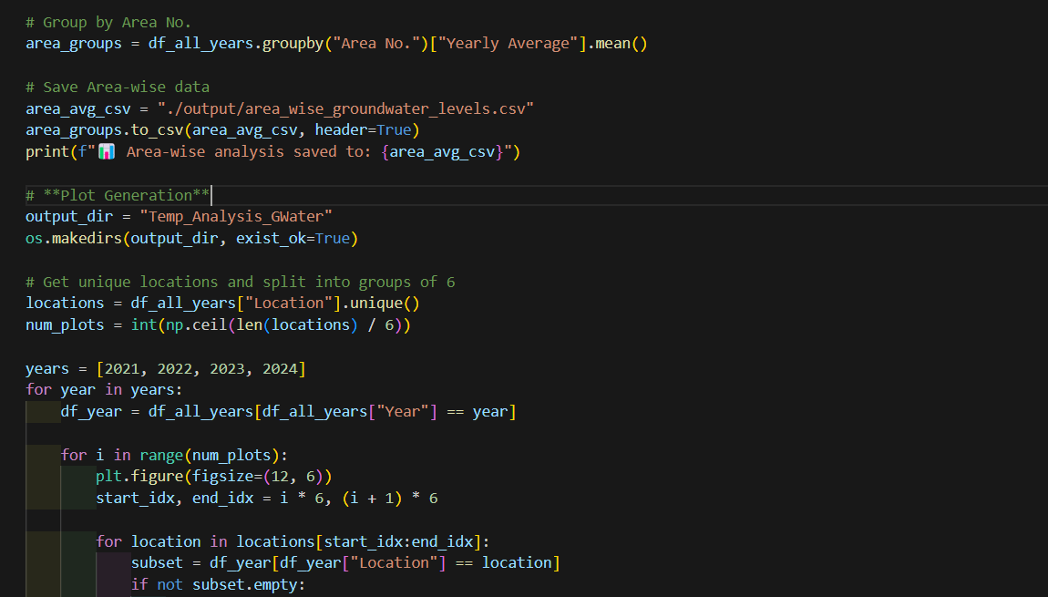
MODULE 2: TEMPORAL ANALYSIS
Objective:
Computed monthly and yearly averages for each ward.

Slide 17
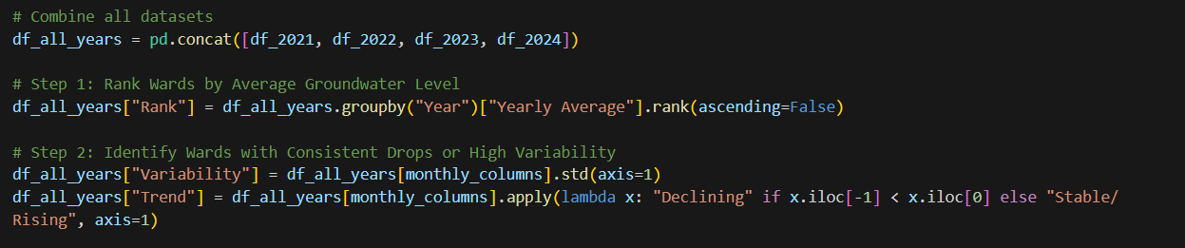
MODULE 3: GROUNDWATER TRENDS ANALYSIS
Classification of Wards Based on Yearly Averages
Categorized wards into:
Declining (continuous decrease in groundwater levels)
Stable/Rising (maintaining or increasing levels)
Variability (fluctuating patterns)

Slide 18
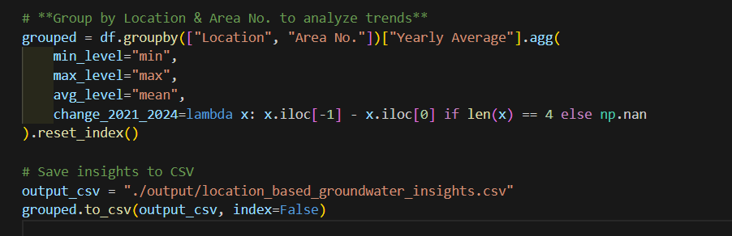
MODULE 4: WARD-WISE GROUNDWATER LEVEL COMPARISON
Metrics Computed:
Minimum, Maximum, and Average Levels
Change from 2021 to 2024

Slide 19
MODULE 5: IDENTIFYING WARDS WITH SIGNIFICANT POST-MONSOON RISES
Post-Monsoon Rise Calculation:
Measures groundwater recharge post-monsoon by taking the difference between October and June levels.
Mean Post-Monsoon Rise (Yearly Computation)
Computes the average recharge for each year.
Flagging Wards with Significant Post-Monsoon Rise
If a ward’s post-monsoon rise is greater than the yearly mean rise, it is considered significant.
Recharge Potential Score: Average post-monsoon rise over multiple years.
FINDINGS
High recharge potential + low levels → Best locations for artificial recharge.
Low recharge potential + low levels → Need urgent water conservation efforts.
High recharge potential + stable levels → Important natural recharge areas to preserve.

Slide 20
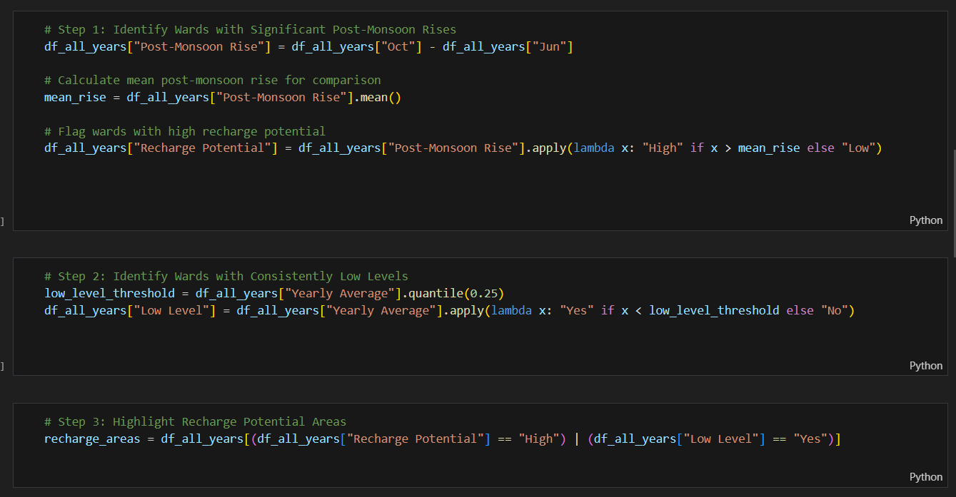
MODULE 5: IDENTIFYING WARDS WITH SIGNIFICANT POST-MONSOON RISES

Slide 21
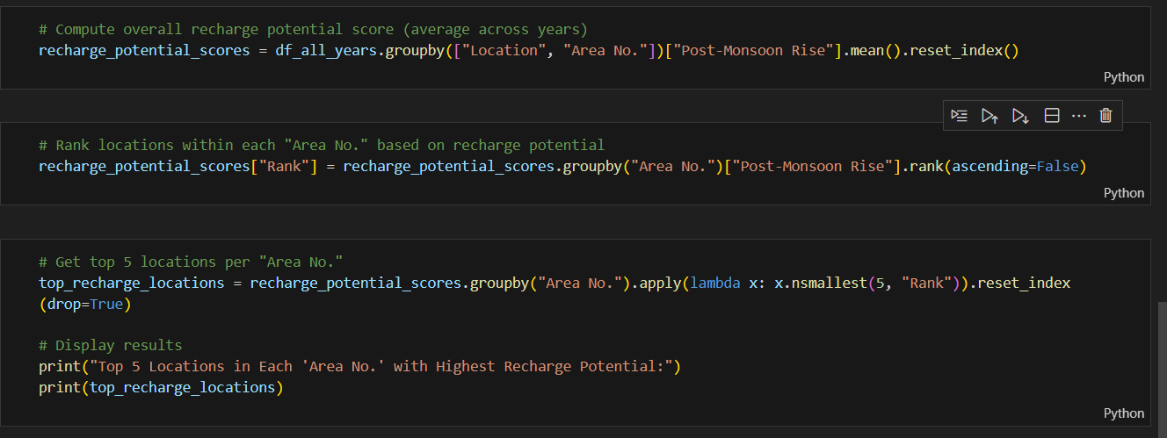
MODULE 6: RANKING WARDS BASED ON RECHARGE POTENTIAL
Ranking within "Area No."
Each ward is ranked based on its recharge potential.
Helps in prioritizing locations for water conservation efforts.
Top 5 Locations per Area
Extracting the top 5 wards per area with the highest recharge potential.

Slide 22
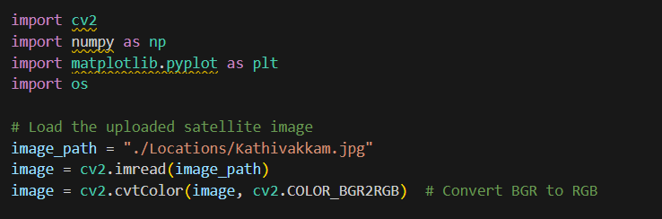
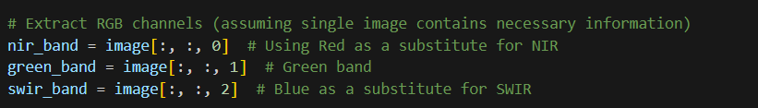
MODULE 7: EXTRACT RGB CHANNELS FROM SATELLITE IMAGES
Satellite images often contain multi-band spectral data (e.g., Red, Green, Blue, Near-Infrared). Extracting RGB channels helps in visualizing surface features.
Process:
Read the image and extract the Red (R), Green (G), and Blue (B) channels separately.
Some datasets also include Near-Infrared (NIR) and Shortwave Infrared (SWIR), which are useful for water/moisture analysis.

Slide 23

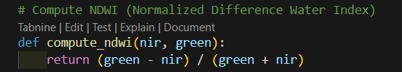
MODULE 8: COMPUTE NDWI AND NDMI
NDWI(Normalized Difference Water Index)enhances water body detection by differentiating water from land and vegetation.
Usage:
Higher NDWI values (closer to 1) indicate water bodies.
Lower NDWI values (closer to -1) indicate non-water areas.

Slide 24

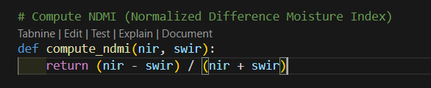
MODULE 8: COMPUTE NDWI AND NDMI
NDMI(Normalized Difference Moisture Index)helps in identifying moisture content in vegetation and soil, crucial for recharge site selection.
Usage:
Higher NDMI values indicate areas with high moisture retention (ideal for recharge).
Lower NDMI values indicate dry areas.

Slide 25
MODULE 9: MORPHOLOGICAL OPERATIONS
1. Identify Green Patches → Uses a threshold (green_band > 0.3) to detect large vegetated areas.
2. Exclude Unwanted Regions → Filters out beaches (high NDWI) and urban areas (low NDMI) to focus on uninhabited green spaces.
3. Refine Green Mask → Ensures only uninhabited green fields are included by reamoving urban and beach zones.
4. Apply Morphological Opening → Uses a 10×10 kernel to remove small, isolated patches and retain large green areas.
5. Highlight Potential Reservoirs → Overlays detected large green patches on the original image in green color for visualization.

Slide 26
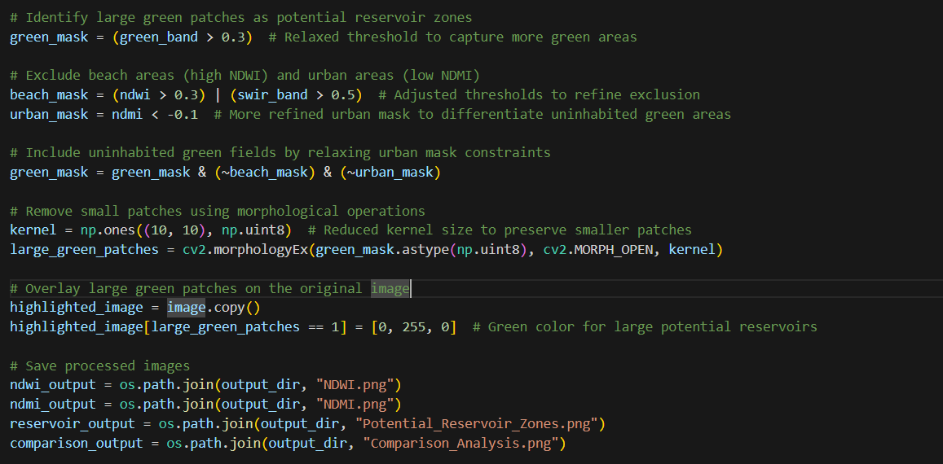
MODULE 9: MORPHOLOGICAL OPERATIONS

Slide 27
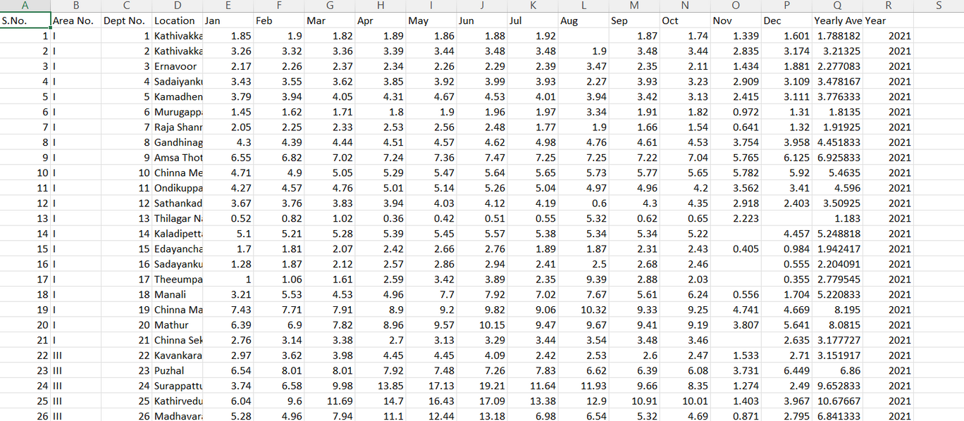
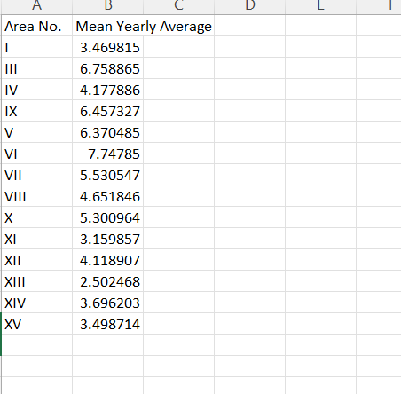
RESULTS
Monthly and Yearly Averages
CSV Name : temporal_analysis_data.csv
Mean Yearly Averages Area-wise
CSV Name : area_wise_groundwater_levels.csv

Slide 28
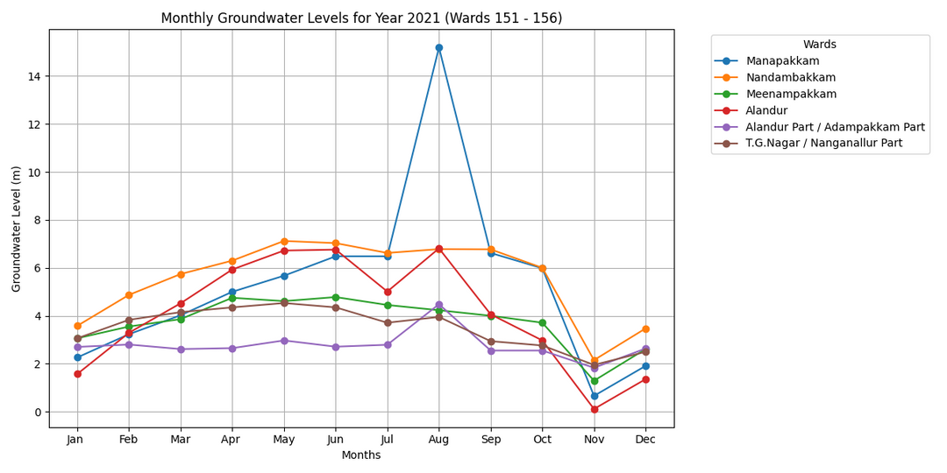
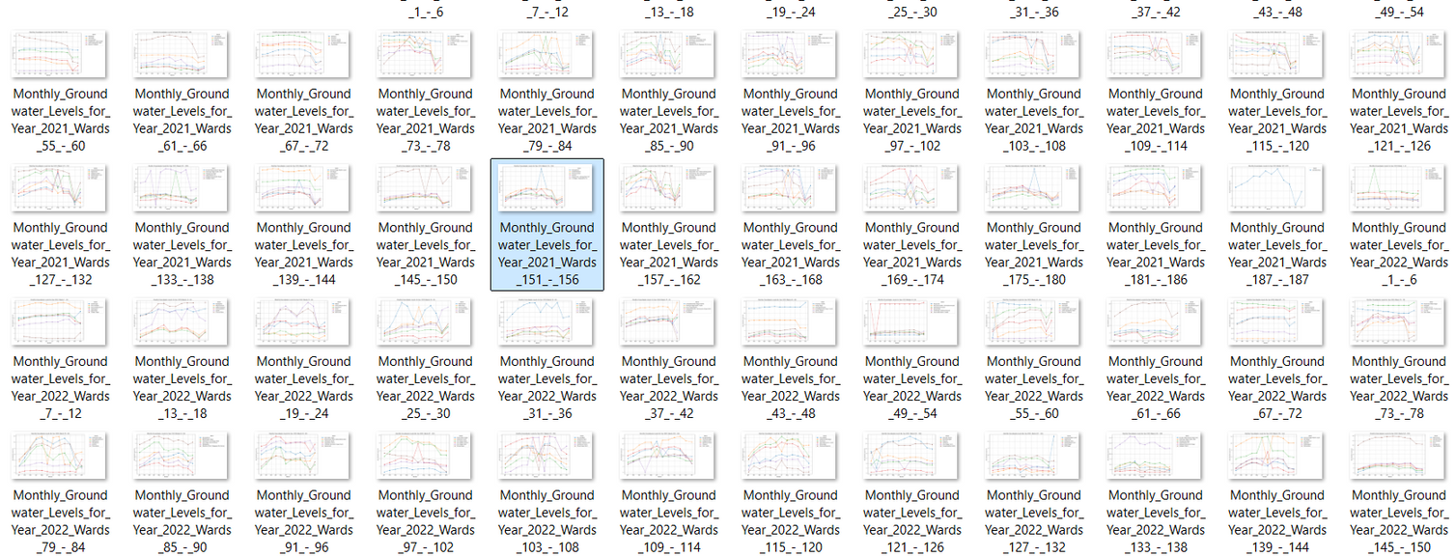
RESULTS
Monthly and Yearly Averages for Ward 151 - 156 for Year 2021
Monthly and Yearly Averages for All Wards across years 2021-2024

Slide 29
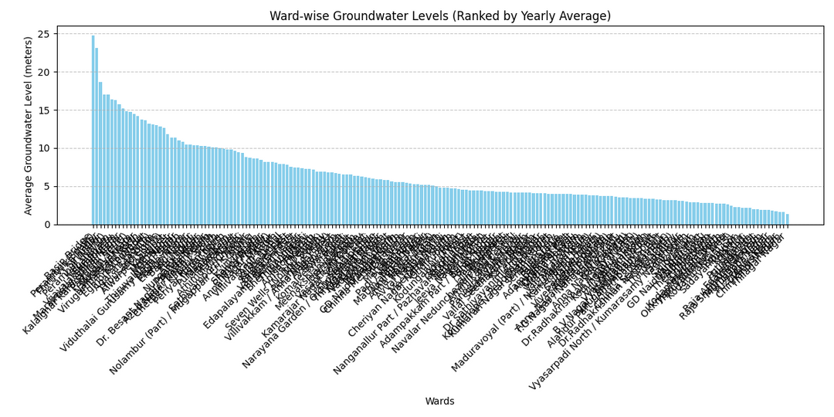
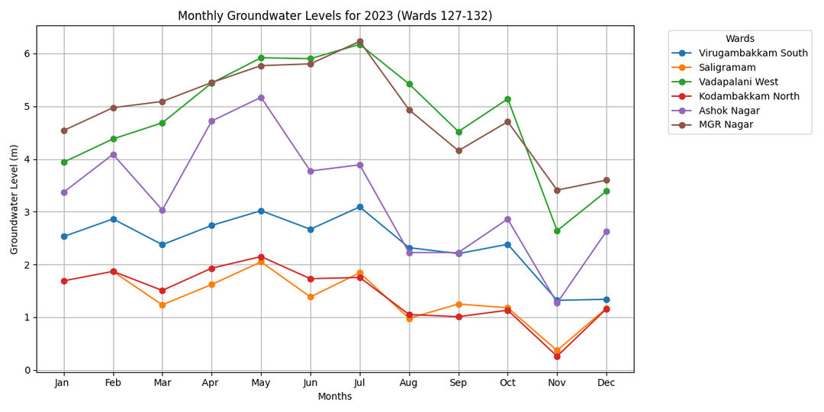
RESULTS
Ward-wise Groundwater Level (Ranked by Yearly Average)
Monthly Groundwater Levels for 2023 (Wards 127-132)

Slide 30
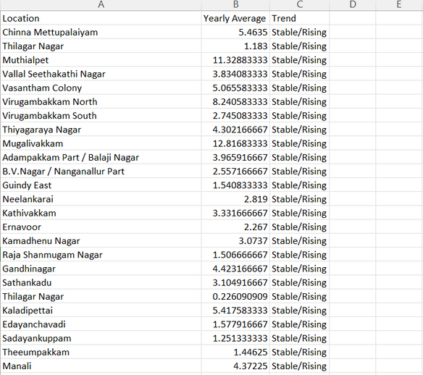
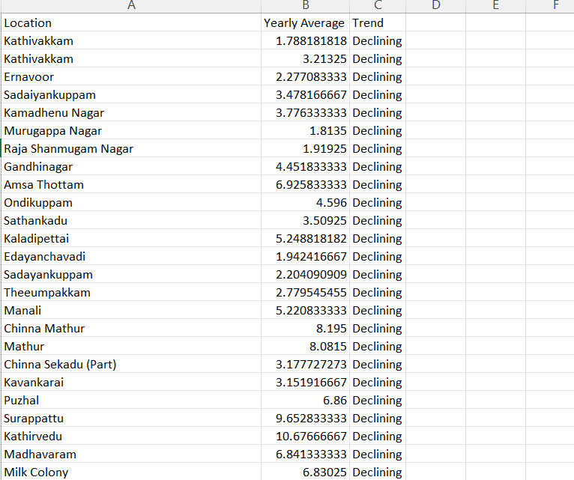
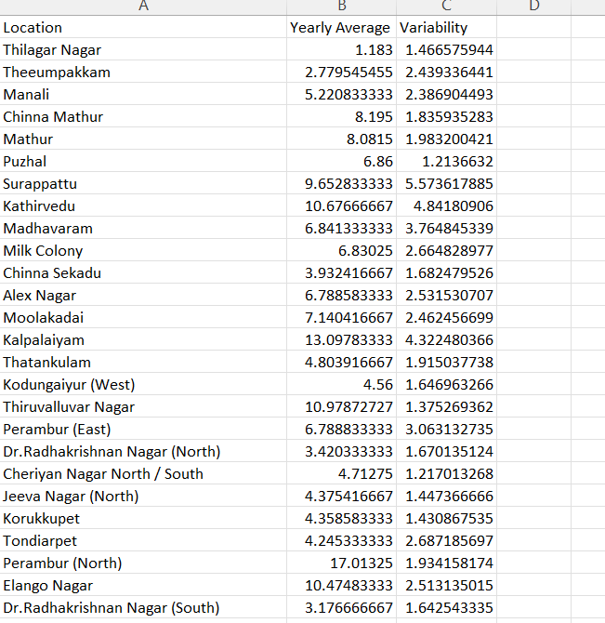
RESULTS
Stable/Rising Trend
CSV Name : stable_rising_wards.csv
Declining Trend
CSV Name : declining_trend_wards.csv
Variability Trend
CSV Name : high_variability_wards.csv

Slide 31
RESULTS
Declining Trend
CSV Name : declining_trend_wards.csv
Variability Trend
CSV Name : high_variability_wards.csv

Slide 32
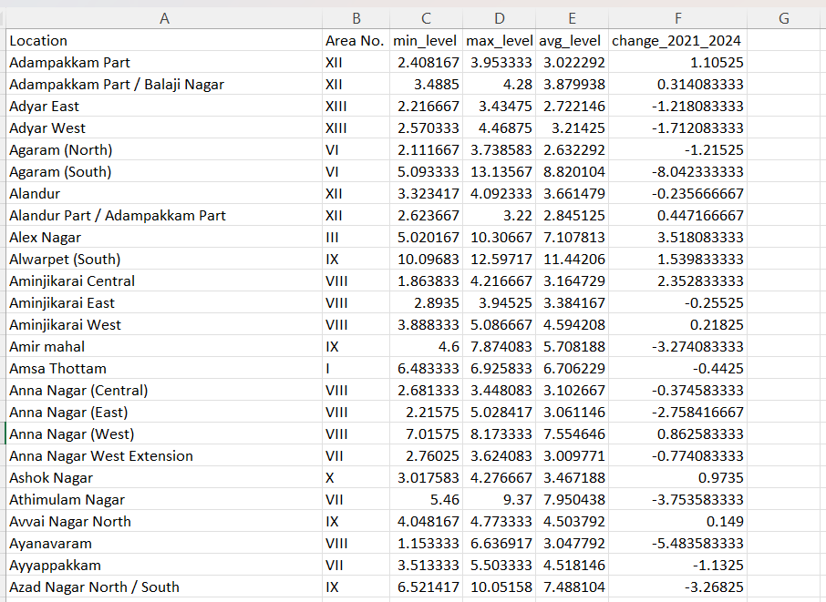
RESULTS
Ward-Wise Groundwater Level Comparison
CSV Name: location_based_groundwater_insightss.csv

Slide 33
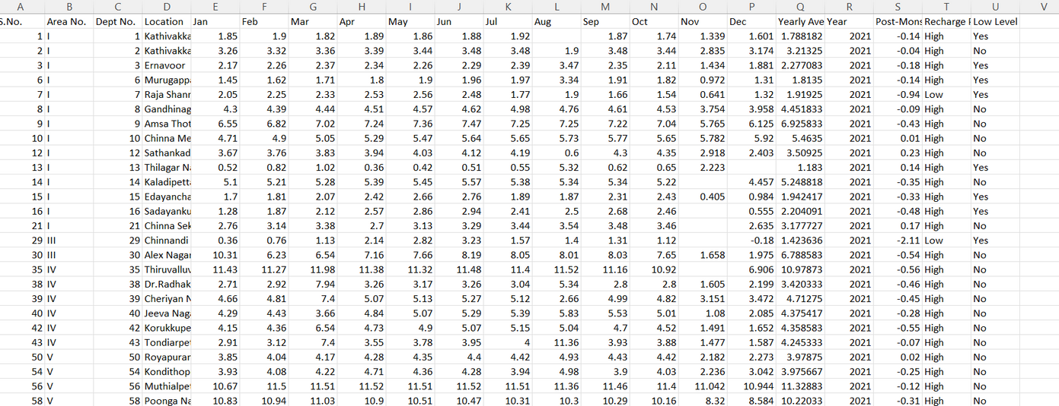
RESULTS
Identifying Wards with Significant Post-Monsoon Rises
CSV Name: recharge_potential_areas.csv

Slide 34
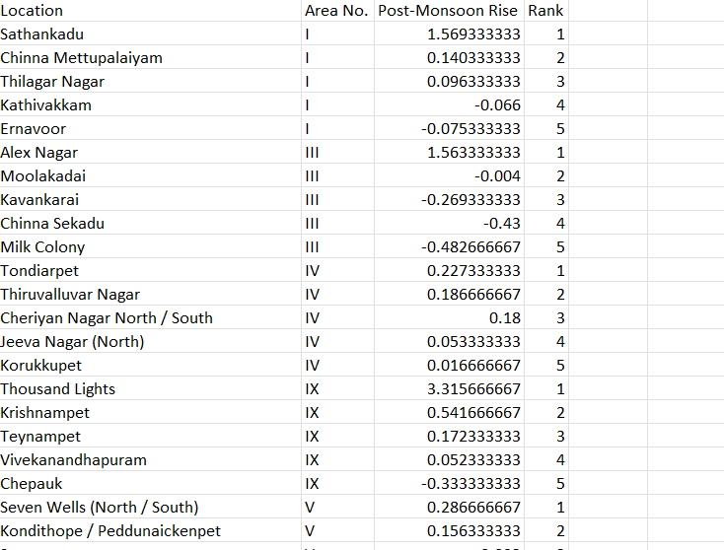
RESULTS
Top 5 Wards in each Area - Based on Recharge Potential
CSV Name: top_recharge_potential_locations.csv

Slide 35
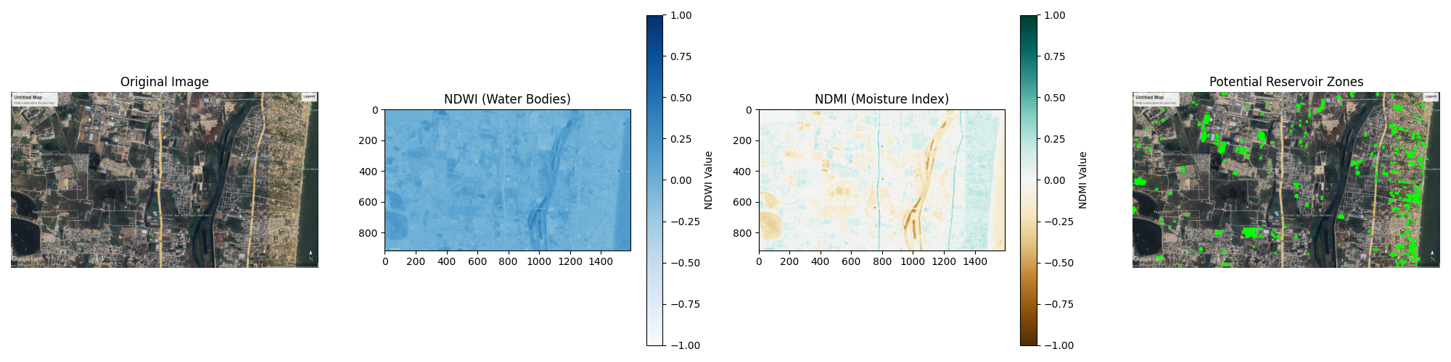
RESULTS
Combined output for satellite image processing for Semmenchery(module 7-9)

Slide 36
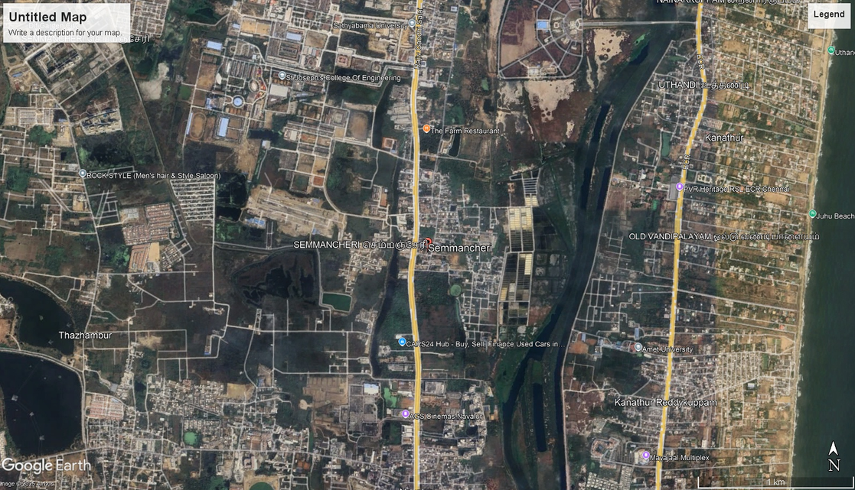
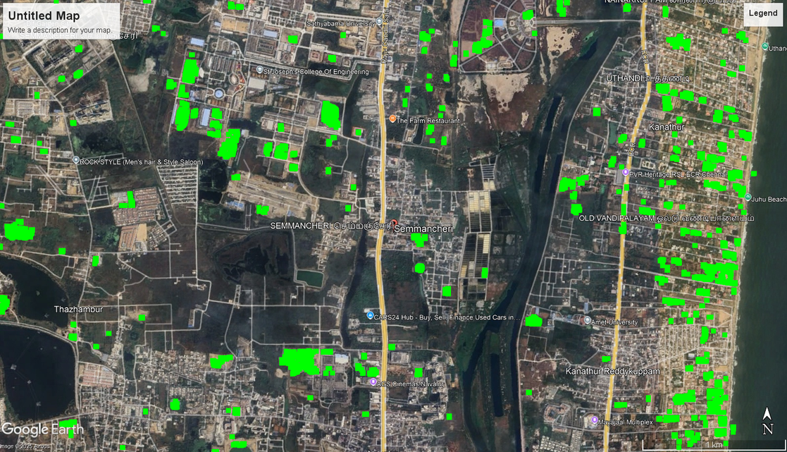
RESULTS
Original Image - Semmenchery
Potential Recharge Spots - Semmenchery

Slide 37
WHAT IS TO BE DONE NEXT
We will be looking for more analysis based on other factors as for now we have covered till NDMI and NDWI.
1. Using Additional Remote Sensing Indices
a) Normalized Difference Vegetation Index (NDVI)
Helps differentiate vegetation from barren land and built-up areas.
Formula: NDVI=NDVI = (NIR - Red) / (NIR + Red)
Usage:
High NDVI (> 0.3) → Dense vegetation (likely better recharge zones).
Low NDVI (< 0.1) → Urban/barren land (less suitable for recharge).
b) Soil-Adjusted Vegetation Index (SAVI)
Corrects for soil brightness in NDVI.
Formula: SAVI= ((NIR - Red) / (NIR + Red + L)) * (1 + L) where L = 0.5 (empirical factor for soil adjustment).

Slide 38
WHAT IS TO BE DONE NEXT
Usage:
Helps differentiate bare soil, sparse vegetation, and dense vegetation.
Areas with moderate vegetation (0.2 < SAVI < 0.4) are good recharge sites.
2. Machine Learning Approaches
a) Unsupervised Clustering (K-Means)
Automatically groups pixels based on NDWI, NDMI, NDVI and SAVI
Helps classify recharge zones without predefined rules.
Usage:
Clusters can be interpreted as high, medium, and low recharge potential zones.
3. Deep Learning for Recharge Zone Detection (CNN Segmentation)
Apply texture analysis (LBP) to classify water, soil, and vegetation.
Train a deep learning model for automatic recharge zone detection.
Model: Train a U-Net or DeepLabV3+ model for semantic segmentation.

Slide 39
REFERENCES
1. Alam, M. J., Kar, S., Zaman, S., Ahamed, S., & Samiya, K. (2022). Forecasting underground water levels: LSTM-based model outperforms GRU and decision tree-based models. 2022 IEEE International Women in Engineering (WIE) Conference.
2. Chen, C., Zhu, X., Kang, X., & Zhou, H. (2021). A deep learning algorithm for groundwater level prediction based on spatial-temporal attention mechanism. 2021 IEEE International Conference on Dependable, Autonomic and Secure Computing.
3. Indriasari, N., Roswintiarti, O., Rasyidy, F. H., Sari, I. L., Kustiyo, Muradi, H., et al. (2023). Temporal variation of MODIS NDVI in the North Coast Java during El Niño and La Niña. 2023 IEEE International Conference on Aerospace Electronics and Remote Sensing Technology (ICARES).
4. Lin, H., et al. (2022). Time series-based groundwater level forecasting using gated recurrent unit deep neural networks. Engineering Applications of Computational Fluid Mechanics.
5. Mu, B., Ma, S., Yuan, S., & Xu, H. (2020). Applying convolutional LSTM network to predict El Niño events: Transfer learning from the data of dynamical model and observation. 2020 IEEE International Conference on Dependable, Autonomic, and Secure Computing.
6. Nhu, V.-H., Hoa, P. V., Melgar-García, L., & Bui, D. T. (2023). Comparative analysis of deep learning and swarm-optimized random forest for groundwater spring potential identification in tropical regions. Remote Sensing MDPI.

Slide 40
REFERENCES
7. Satizábal-Alarcón, D. A., Suhogusoff, A., & Ferrari, L. C. (2022). Groundwater storage changes in the Amazon River Basin using machine learning models to downscale GRACE/GRACE-FO data. Science of the Total Environment, 912, 168958.
8. Shekhar, M., Shindekar, M., Tomer, S. K., & Goswami, P. (2013). Urban groundwater vulnerability under climate change and management scenarios. Earth Interactions, 17.
9. Sriram, R., & Jasmeen. (2023). Groundwater level prediction: A novel study on machine learning-based approach with regression models for sustainable resource management. 2023 IEEE International Conference on Cloud Computing in Emerging Markets (CCEM).
10. Shu, G., Liang, C., & Yin, Y. (2023). GSTCN: Graph-based spatial-temporal convolutional networks for advanced ENSO forecasting. 2023 International Conference on Computer Science and Automation Technology (CSAT).
11. Subbarayan, S., & Devanatham, A. (2023). Flood susceptibility mapping of northeast coastal districts of Tamil Nadu, India, using multi-source geospatial data and machine learning techniques. Research Gate.
12. Sundararajan, K., Garg, L., Srinivasan, K., Bashir, A. K., Kaliappan, J., Ganapathy, P. G., Selvaraj, S. K., & Meena, T. (2023). Drought modeling using machine learning approaches. Computer Modelling in Engineering & Sciences. Tech Science Press.

Slide 41
REFERENCES
13. Sundaram, S., Devaraj, S., & Yarrakula, K. (2023). Mapping and assessing spatial extent of floods from multitemporal synthetic aperture radar images: A case study over Chennai city, India. Research Square.
14. Zhang, Y., Wang, R., Yang, M., Zhu, M., & Ye, C. (2018). Using full-traversal addition-subtraction frequency (ASF) method to predict possible El Niño events in 2019, 2020 and so forth. 2018 Chinese Control and Decision Conference (CCDC).
15. Phu, G.-H., Joa, P. V., García, L., & Bui, D. T. (2021). Comparative analysis of machine learning and random forest for groundwater spring potential identification in tropical regions. Remote Sensing MDPI.

Slide 42
Thank you!
PROJECT-II (BCSE498J) PANEL REVIEW - II
Shaikh Rumman Fardeen
Shashank Kumar
February, 2025

